Slide 1
CSE 453
High Performance Database Systems
Course Teacher : Md Tarikul Islam Papon

Slide 2
Log Structured Merge Trees

Slide 3
Log Structured Merge Trees
Useful when-
Huge dataset
Rapid update and insertion
Fast Lookup
Invented by Patrick O'Neil in 1996

Slide 4
Applications of LSM Tree
Bigtable (Google)
Cassandra (Facebook)
Dynamo (Amazon)
HBase (Apache)
PNUTS (Yahoo!)
MongoDB (Wired Tiger)
SQLite
LevelDB & RocksDB
And many more……..

Slide 5
LSM Tree-Advantages
Superior write performance
High Space Utilization
Tunability of different parameters
Simplified concurrency control and recovery
Can serve a large variety of workloads

Slide 6
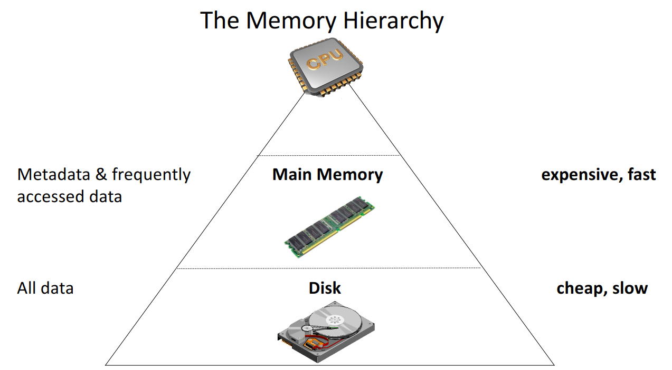
Memory Hierarchy

Slide 7
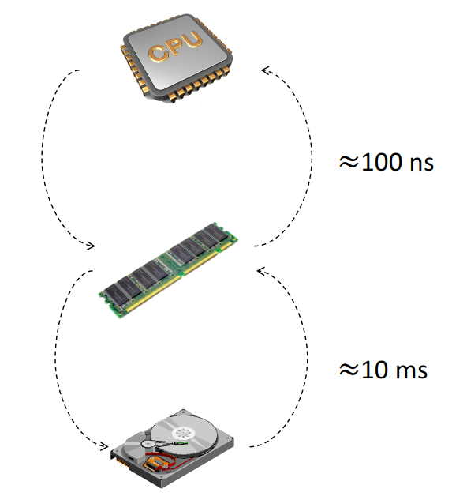
Memory Hierarchy

Slide 8
LSM Tree - Fundamentals
Performs out-of-places updates thus enabling
High throughput for updates
Good space efficiency
They achieve these by
Buffering all updates in main memory
Flushing the buffer to disk as a sorted run whenever needed
Organize disk resident runs into a number of levels of increasing sizes

Slide 9
Log Structured Merge Trees
Maintain key-value pairs.
Maintain data in two or more separate structures, each of which is optimized for its respective underlying storage medium
Data is synchronized between the two structures efficiently, in batches.

Slide 10
Simplest LSM Tree
Two levels with level C0 and C1
C0 is always present in the memory
C1 is always present in the disk

Slide 11
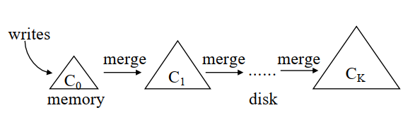
Simplest LSM Tree

Slide 12
Simplest LSM Tree
Whenever a request comes to insert/update any information to the database, entry is made into the C0 level
If the insertion causes the C₀ to exceed a certain size threshold, a contiguous segment of entries is removed from C₀ and merged into C₁ on disk.
Data is efficiently migrated across media in rolling batches, using an algorithm reminiscent of merge sort.

Slide 13
Rolling Merge
Rolling merge happens in a series of steps.
Every step involves merging of disk page sized leaf nodes from C1 level with leaf level entries from C0 level forming a newly merged leaf node of C1 tree.
The newly merged leaf node is generally stored on a new disk space

Slide 14
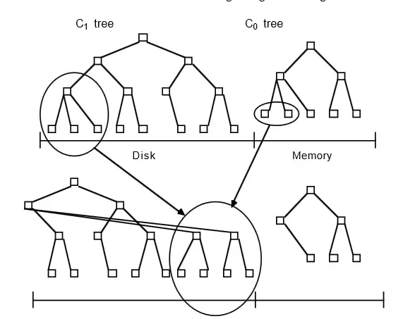
Rolling Merge

Slide 15
LSM Tree
Most LSM trees used in practice employ multiple levels.
Level 0 is kept in main memory, and might be represented using a tree (Mostly AVL Tree).
The on-disk data is organized into sorted runs of data. Each run contains data sorted by the index key. Resembles a B-tree!!

Slide 16
LSM Tree
The original paper on LSM-trees further showed that under a stable workload, where the number of levels remains static, write performance is optimized when the size ratios between all adjacent components are the same.

Slide 17
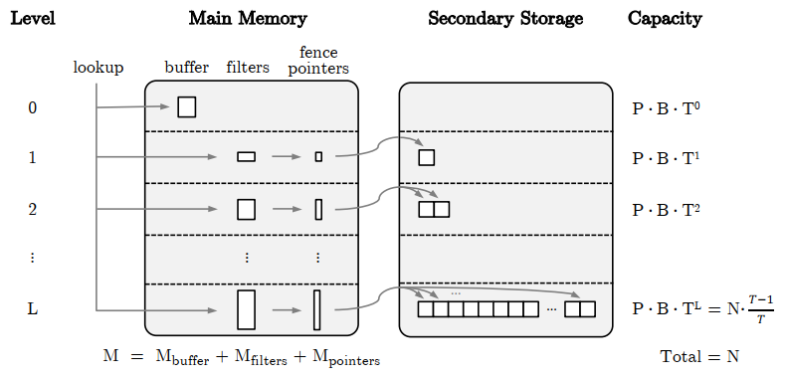
LSM Tree
We are considering both keys and values are stored inside the LSM-tree, although it is also possible to store large values outside of the LSM tree and point to them using fixed-width pointers attached to keys.

Slide 18
LSM Tree
Level 0 refers to an in-memory buffer, and the rest of the levels refer to data in secondary storage.

Slide 19
LSM Tree
If an update refers to a key which already exists in the buffer then the original entry is replaced in-place and only the latest one survives.

Slide 20
LSM Tree
When the buffer’s capacity is reached, its entries are sorted by key into an array and flushed to Level 1 in secondary storage. Such arrays can be referred as runs.

Slide 21
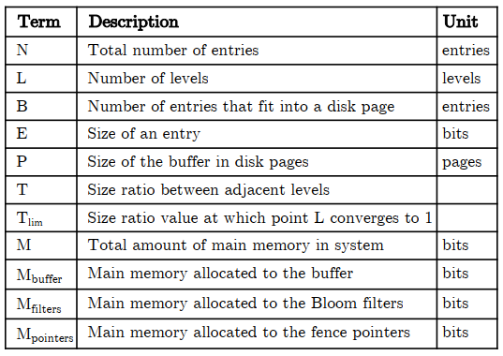
LSM Tree

Slide 22
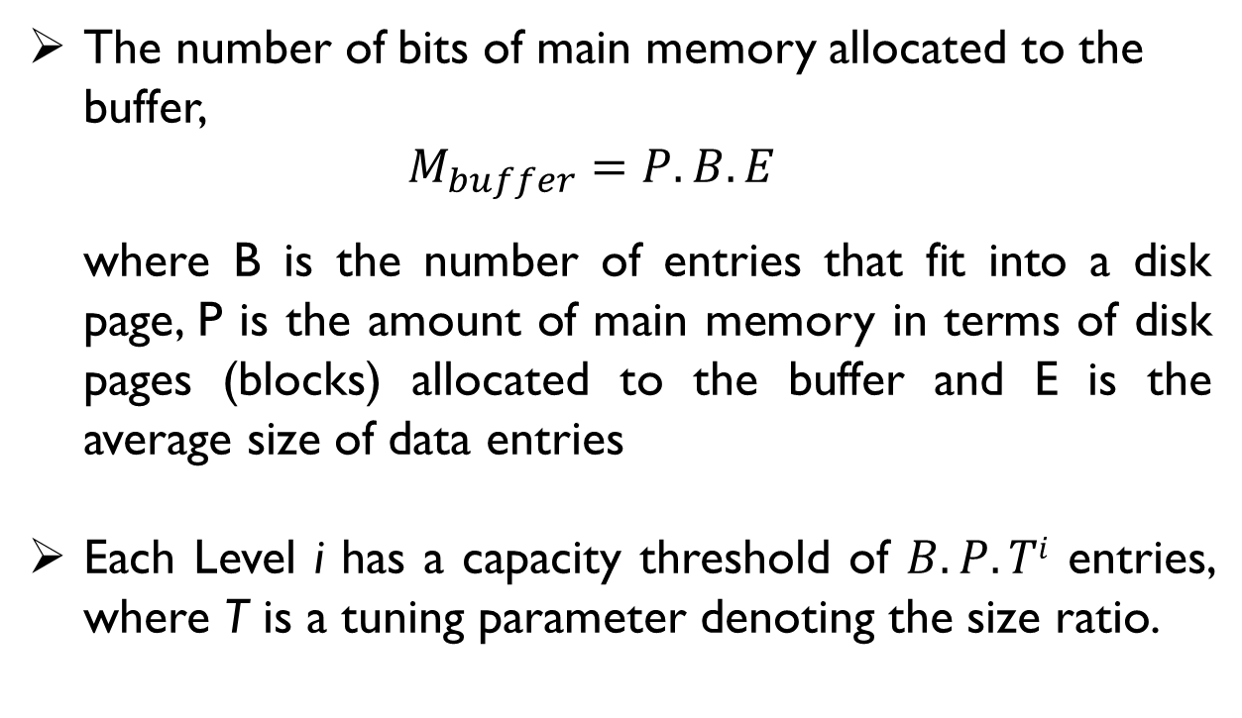
LSM Tree
The number of bits of main memory allocated to the buffer, $M_{buffer}=P.B.E$
where B is the number of entries that fit into a disk page, P is the amount of main memory in terms of disk pages (blocks) allocated to the buffer and E is the average size of data entries
Each Level i has a capacity threshold of $B.P.Ti$ entries, where T is a tuning parameter denoting the size ratio.

Slide 23
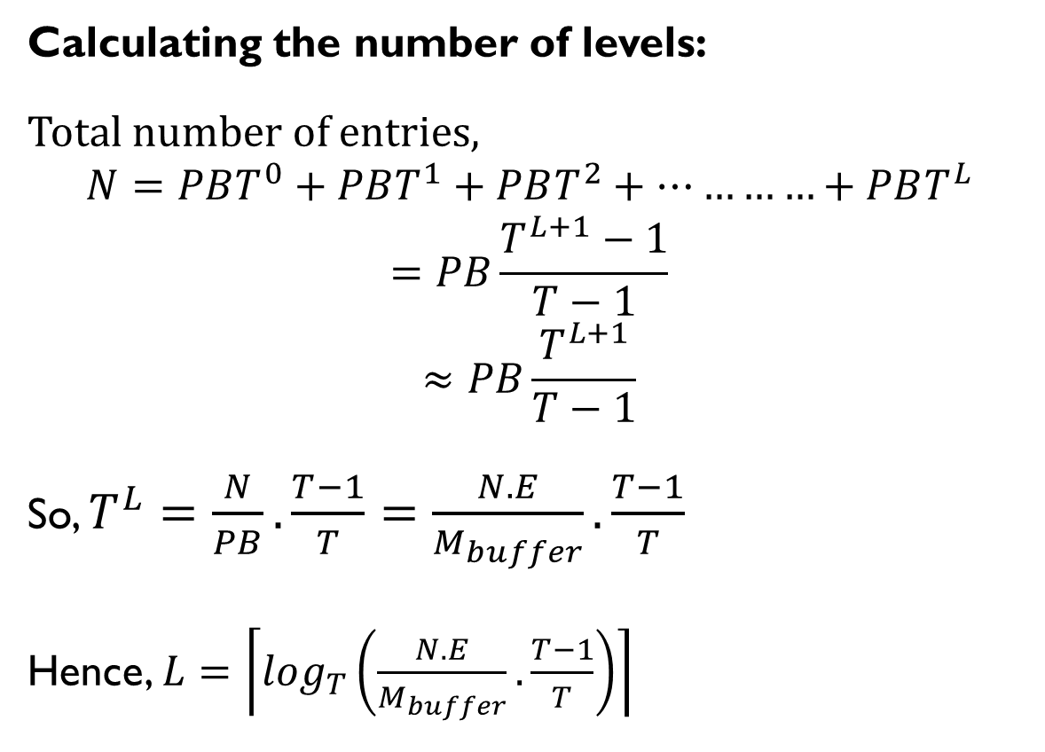
LSM Tree
Calculating the number of levels:
Total number of entries,
$$N=PBT^{0}+PBT^{1}+PBT^{2}+…………+PBT^{L}$$
$$=PB\frac{T^{L+1}−1}{T−1}$$
$$≈PB\frac{T^{L+1}}{T−1}$$
So, $T^{L}=\frac{N}{PB}.\frac{T−1}{T}=\frac{N.E}{M_{buffer}}.\frac{T−1}{T}$
Hence, $L=\left\lceil \log_{T}\left(\frac{N.E}{M_{buffer}}.\frac{T−1}{T}\right)\right\rceil$

Slide 24
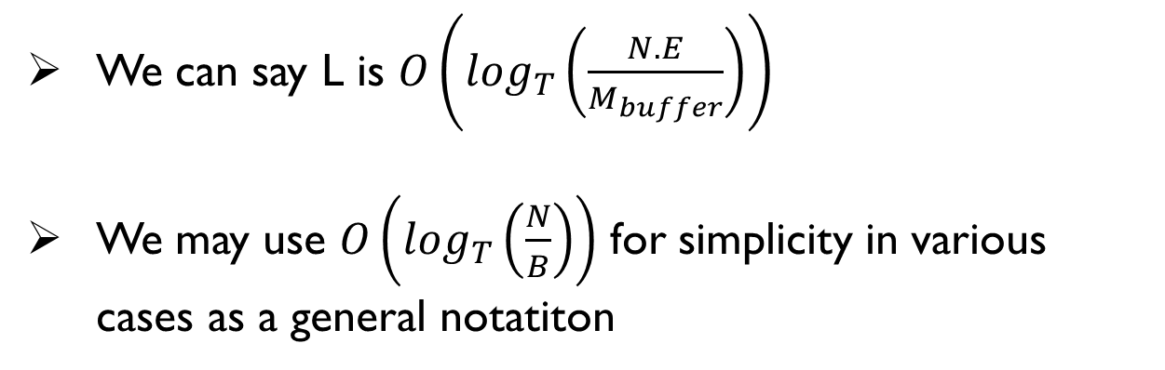

A Very Important Note
$$L=\left\lceil \log_{T}\left(\frac{N.E}{M_{buffer}}.\frac{T−1}{T}\right)\right\rceil$$
We can say L is $O\left(\log_{T}\left(\frac{N.E}{M_{buffer}}\right)\right)$
We may use $O\left(\log_{T}\left(\frac{N}{B}\right)\right)$ for simplicity in various cases as a general notatiton

Slide 25
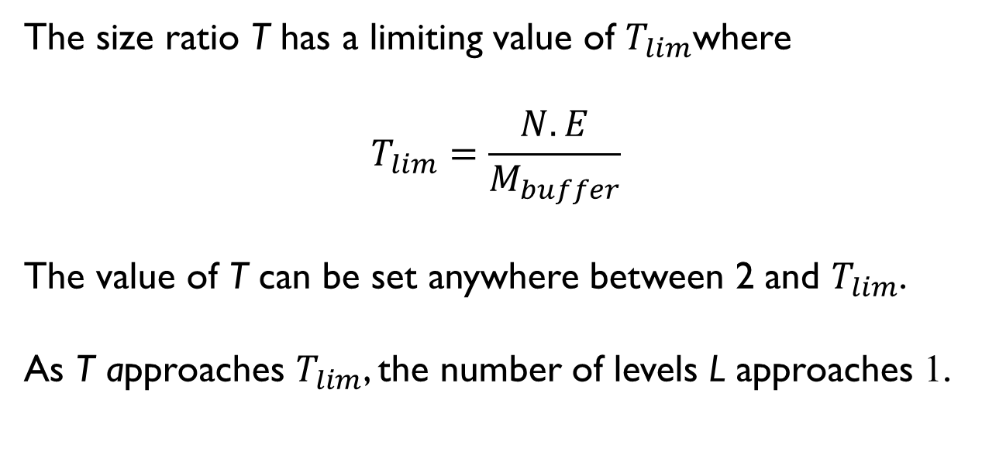
LSM Tree
The size ratio T has a limiting value of $T_{lim}$where
$$T_{lim}=\frac{N.E}{M_{buffer}}$$
The value of T can be set anywhere between 2 and $T_{lim}$.
As T approaches $T_{lim}$, the number of levels L approaches 1.

Slide 26
LSM Tree- Merge Operations
To bound the number of runs that a lookup has to probe, an LSM-tree organizes runs among the different levels based on their sizes, and it merges runs of similar sizes.
There are two possible merging policies:
Leveling
Tiering

Slide 27
Levelled LSM Tree
With leveling, there is at most one run per Level i, and any run that is moved from Level i - 1 to Level i is immediately sort-merged with the run at Level i, if one exists.
Levelled LSM tree is optimized for Lookup

Slide 28
Levelled LSM Tree
Level
0
1
2
Insert 5
57
Size Ratio, T = 3
7
7
7
7
7
7
7
7
7
7
7
7
….7

Slide 29
Levelled LSM Tree
Level
0
1
2
Insert 11
57
11
Size Ratio, T = 3
7
7
7
7
7
7
7
7
7
7
7
7
….7
Need to flush & merge!!

Slide 30
Levelled LSM Tree
Level
0
1
2
7
Size Ratio, T = 3
5
117
7
7
7
7
7
7
7
7
7
7
….7

Slide 31
Levelled LSM Tree
Level
0
1
2
Insert 8
8
Size Ratio, T = 3
5
117
7
7
7
7
7
7
7
7
7
7
….7

Slide 32
Levelled LSM Tree
Level
0
1
2
Insert 2
8
2
Size Ratio, T = 3
5
117
7
7
7
7
7
7
7
7
7
7
….7
Need to flush & merge!!

Slide 33
Levelled LSM Tree
Level
0
1
2
Size Ratio, T = 3
2
57
8
117
7
7
7
7
7
7
7
7
….7

Slide 34
Levelled LSM Tree
Level
0
1
2
Insert 1
1
Size Ratio, T = 3
2
57
8
117
7
7
7
7
7
7
7
7
….7

Slide 35
Levelled LSM Tree
Level
0
1
2
Insert 6
1
6
Size Ratio, T = 3
2
57
8
117
7
7
7
7
7
7
7
7
….7
Need to flush & merge!!

Slide 36
Levelled LSM Tree
Level
0
1
2
Size Ratio, T = 3
1
27
5
67
8
117
7
7
7
7
7
7
….7
Need to flush & merge again!!

Slide 37
Levelled LSM Tree
Level
0
1
2
Size Ratio, T = 3
7
7
7
1
2
5
6
8
11
….7

Slide 38
Tiered LSM Tree
With tiering, up to T runs can accumulate at Level i, at which point these runs are sort-merged.
Tiered LSM tree is optimized for update

Slide 39
Tiered LSM Tree
Level
0
1
2
Insert 5
57
Size Ratio, T = 3
7
7
7
7
7
7
7
7
7
7
7
7
….7

Slide 40
Tiered LSM Tree
Level
0
1
2
Insert 11
57
11
Size Ratio, T = 3
7
7
7
7
7
7
7
7
7
7
7
7
….7
Need to flush!!

Slide 41
Tiered LSM Tree
Level
0
1
2
7
Size Ratio, T = 3
5
11
7
7
7
7
7
7
7
7
7
7
….7

Slide 42
Tiered LSM Tree
Level
0
1
2
Insert 8
8
Size Ratio, T = 3
5
11
7
7
7
7
7
7
7
7
7
7
….7

Slide 43
Tiered LSM Tree
Level
0
1
2
Insert 2
8
2
Size Ratio, T = 3
5
11
7
7
7
7
7
7
7
7
7
7
….7
Need to flush!!

Slide 44
Tiered LSM Tree
Level
0
1
2
Size Ratio, T = 3
5
11
2
8
7
7
7
7
7
7
7
7
….7

Slide 45
Tiered LSM Tree
Level
0
1
2
Insert 1
1
Size Ratio, T = 3
5
11
2
8
7
7
7
7
7
7
7
7
….7

Slide 46
Tiered LSM Tree
Level
0
1
2
Insert 6
1
6
Size Ratio, T = 3
5
11
2
8
7
7
7
7
7
7
7
7
….7
Need to flush!!

Slide 47
Tiered LSM Tree
Level
0
1
2
Insert 6
Size Ratio, T = 3
5
11
2
8
1
6
7
7
7
7
7
7
….7
Need to merge & flush!!

Slide 48
Tiered LSM Tree
Level
0
1
2
Size Ratio, T = 3
1
2
5
6
8
11
….7

Slide 49
Levelled vs Tiered
A leveled LSM-tree merges runs more greedily and therefore gives a tighter bound on the overall number of runs that a lookup has to probe, but this comes at the expense of a higher amortized update cost .

Slide 50
Lookup in LSM Tree
A point lookup starts from the buffer and traverses the levels from lowest to highest (and the runs within those levels from youngest to oldest in the case of tiering).
When it finds the first matching entry it terminates.
There is no need to look further because entries with the same key at older runs are superseded.
A zero-result lookup (i.e., where the target key does not exist) incurs a potentially high I/O cost because it probes all runs within all levels.

Slide 51
Probing a Run
Modern designs simply store an array of fence pointers in main memory with min/max information for every disk page of every run.
Thus, a lookup initially searches the fence pointers. If it is a point lookup, it then reads the appropriate disk page with one I/O, or if it is a range lookup it begins a scan from this page.
With 16 KB disk pages and 4 byte pointers, the fence pointers are smaller by ≈ 4 orders of magnitude than the raw data size.

Slide 52
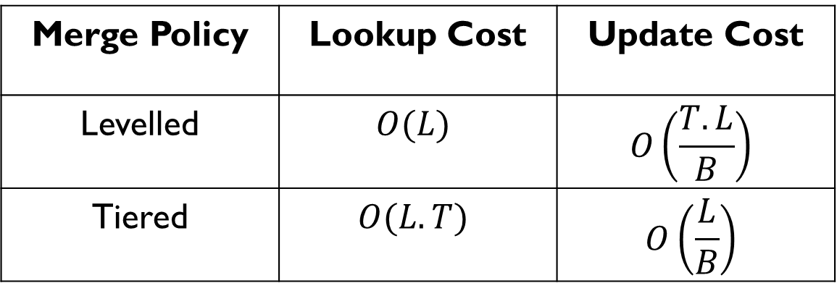
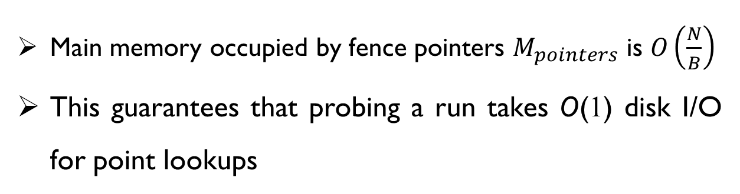
Cost Analysis
Main memory occupied by fence pointers $M_{pointers}$ is $O\left(\frac{N}{B}\right)$
This guarantees that probing a run takes O(1) disk I/O for point lookups
Merge Policy | Lookup Cost | Update Cost
Levelled | $$O(L)$$ | $$O\left(\frac{T.L}{B}\right)$$
Tiered | $$O(L.T)$$ | $$O\left(\frac{L}{B}\right)$$

Slide 53
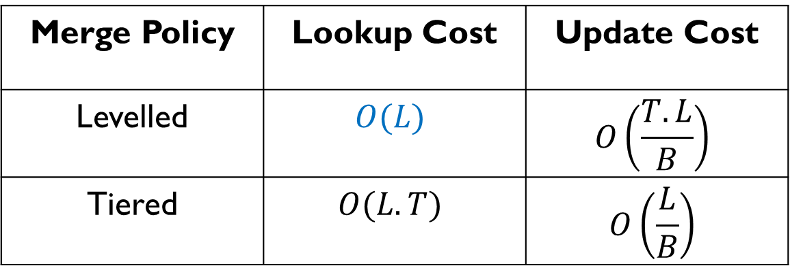
Cost Analysis
For a leveled LSM-tree, the worst-case lookup cost is given by O(L) I/Os, because there are O(L) levels, there is one run per level, the cost of probing a run is one I/O due to the fence pointers.
Merge Policy | Lookup Cost | Update Cost
Levelled | $$O(L)$$ | $$O\left(\frac{T.L}{B}\right)$$
Tiered | $$O(L.T)$$ | $$O\left(\frac{L}{B}\right)$$

Slide 54
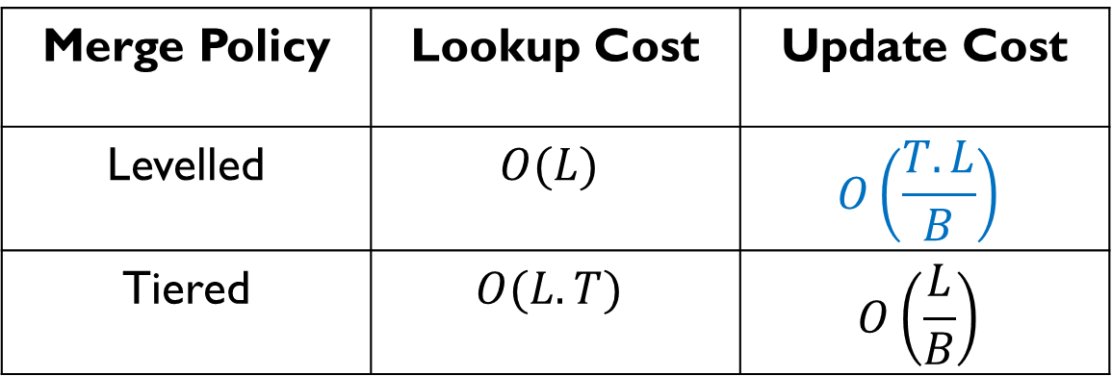
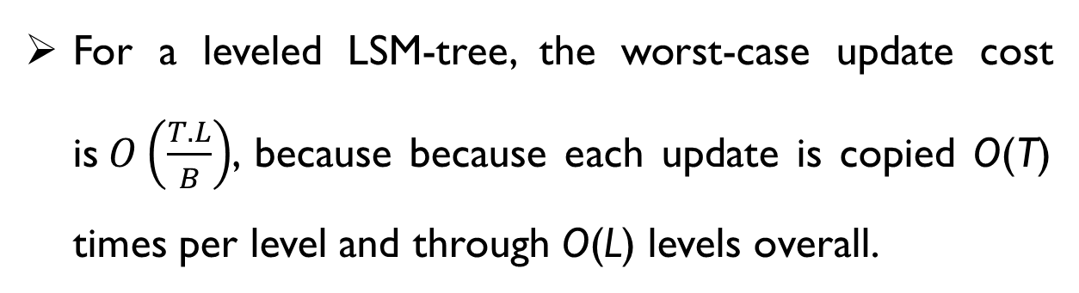
Cost Analysis
For a leveled LSM-tree, the worst-case update cost is$O\left(\frac{T.L}{B}\right)$, because because each update is copied O(T) times per level and through O(L) levels overall.
Merge Policy | Lookup Cost | Update Cost
Levelled | $$O(L)$$ | $$O\left(\frac{T.L}{B}\right)$$
Tiered | $$O(L.T)$$ | $$O\left(\frac{L}{B}\right)$$

Slide 55
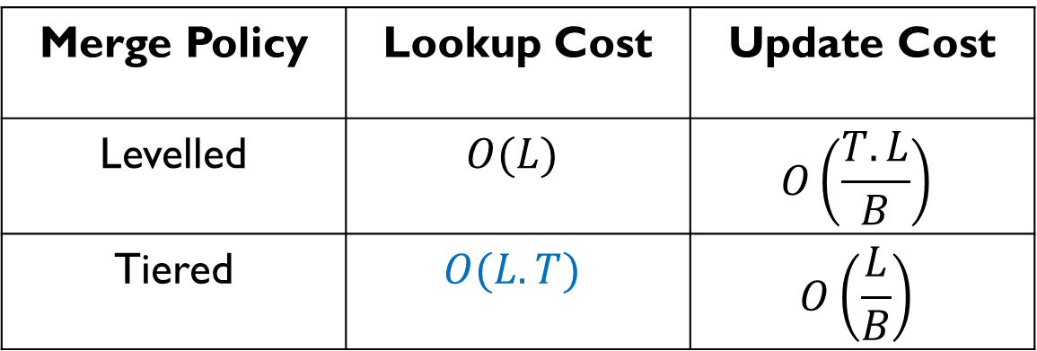
Cost Analysis
For a tiered LSM-tree, the worst-case lookup cost is given by O(L.T) I/Os, because there are O(L) levels, O(T) runs per level, the cost of probing each run is one I/O due to the fence pointers.
Merge Policy | Lookup Cost | Update Cost
Levelled | $$O(L)$$ | $$O\left(\frac{T.L}{B}\right)$$
Tiered | $$O(L.T)$$ | $$O\left(\frac{L}{B}\right)$$

Slide 56
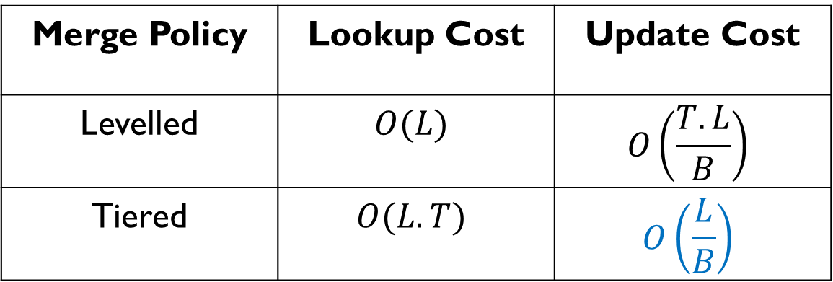
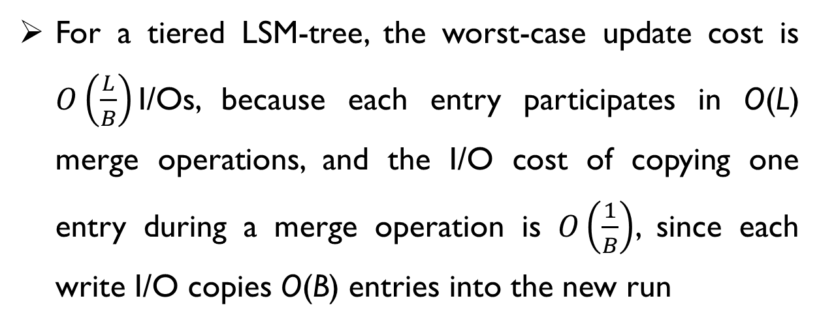
Cost Analysis
For a tiered LSM-tree, the worst-case update cost is $O\left(\frac{L}{B}\right)$I/Os, because each entry participates in O(L) merge operations, and the I/O cost of copying one entry during a merge operation is $O\left(\frac{1}{B}\right)$, since each write I/O copies O(B) entries into the new run
Merge Policy | Lookup Cost | Update Cost
Levelled | $$O(L)$$ | $$O\left(\frac{T.L}{B}\right)$$
Tiered | $$O(L.T)$$ | $$O\left(\frac{L}{B}\right)$$

Slide 57
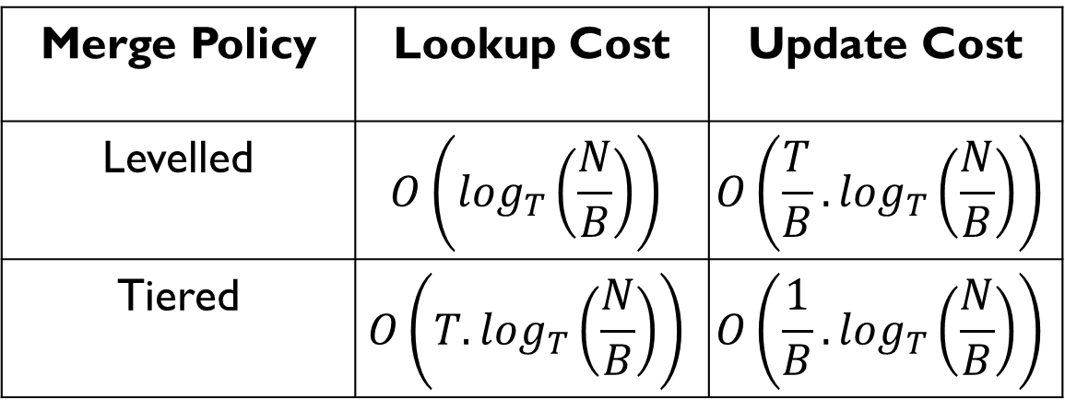
Cost Analysis
The costs can also be expressed as
Merge Policy | Lookup Cost | Update Cost
Levelled | $$O\left(\log_{T}\left(\frac{N}{B}\right)\right)$$ | $$O\left(\frac{T}{B}.\log_{T}\left(\frac{N}{B}\right)\right)$$
Tiered | $$O\left({T.log}_{T}\left(\frac{N}{B}\right)\right)$$ | $$O\left(\frac{1}{B}.\log_{T}\left(\frac{N}{B}\right)\right)$$

Slide 58
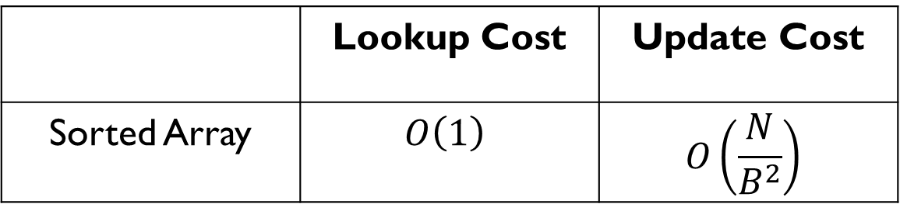
Cost Analysis
Consider we have N entries and B entries fit into a disk page.
What will be the costs for sorted array?
 | Lookup Cost | Update Cost
Sorted Array | $$O\left(1\right)$$ | $$O\left(\frac{N}{B^{2}}\right)$$

Slide 59
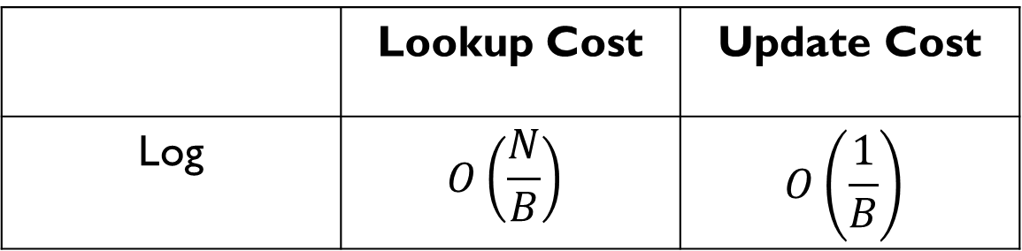
Cost Analysis
Consider we have N entries and B entries fit into a disk page.
What will be the costs for Log?
 | Lookup Cost | Update Cost
Log | $$O\left(\frac{N}{B}\right)$$ | $$O\left(\frac{1}{B}\right)$$

Slide 60
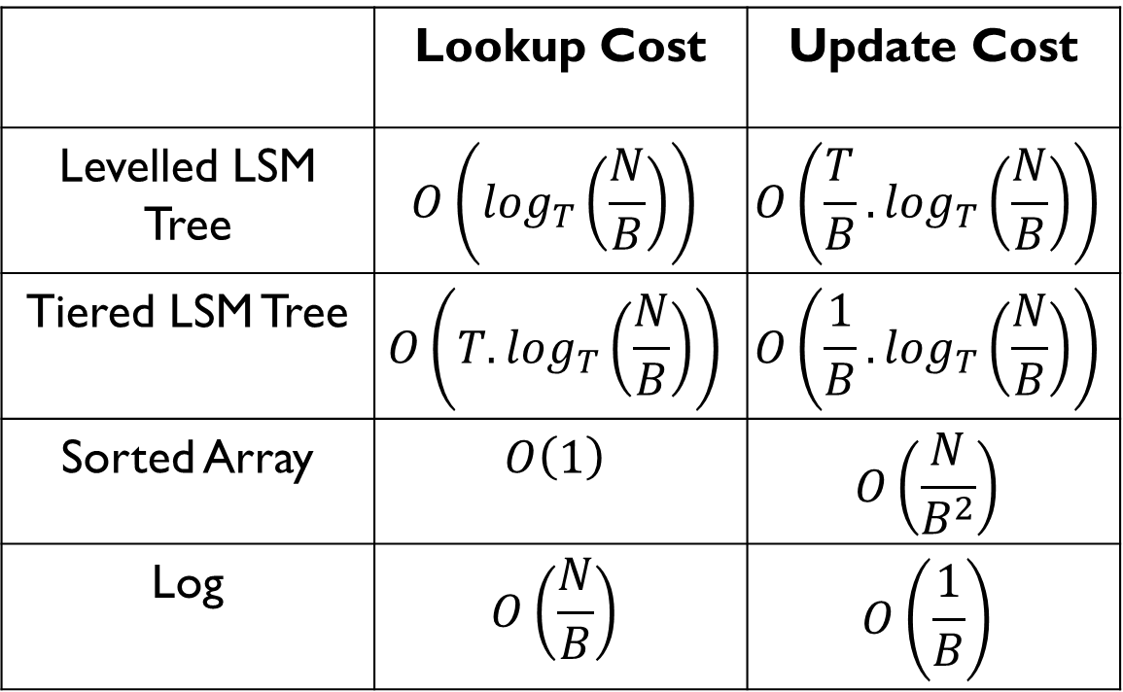
Cost Analysis- Summary
 | Lookup Cost | Update Cost
Levelled LSM Tree | $$O\left(\log_{T}\left(\frac{N}{B}\right)\right)$$ | $$O\left(\frac{T}{B}.\log_{T}\left(\frac{N}{B}\right)\right)$$
Tiered LSM Tree | $$O\left({T.log}_{T}\left(\frac{N}{B}\right)\right)$$ | $$O\left(\frac{1}{B}.\log_{T}\left(\frac{N}{B}\right)\right)$$
Sorted Array | $$O\left(1\right)$$ | $$O\left(\frac{N}{B^{2}}\right)$$
Log | $$O\left(\frac{N}{B}\right)$$ | $$O\left(\frac{1}{B}\right)$$
All costs consider fence pointer without bloom filter

Slide 61
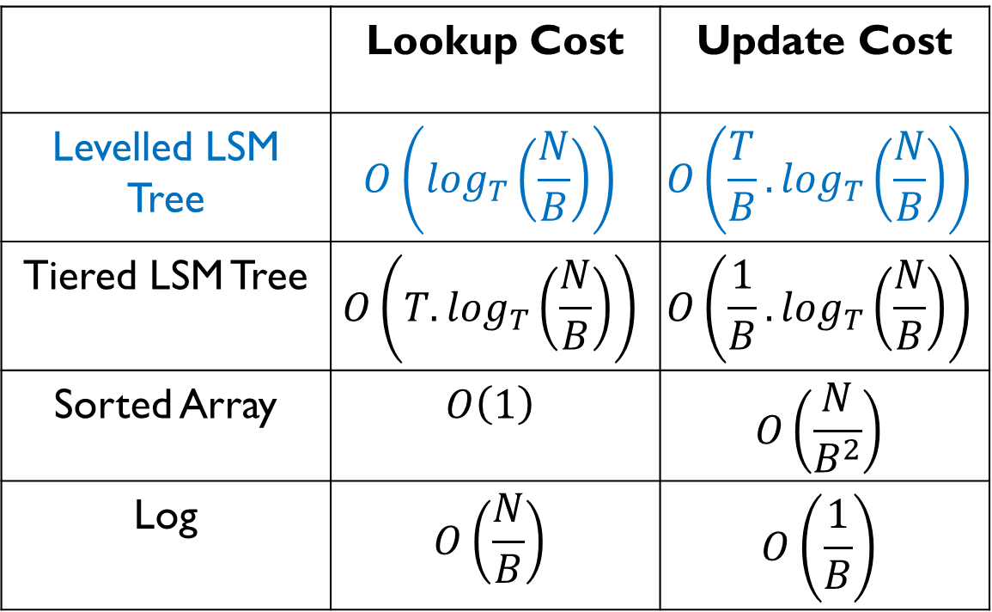
Cost Analysis- Summary
 | Lookup Cost | Update Cost
Levelled LSM Tree | $$O\left(\log_{T}\left(\frac{N}{B}\right)\right)$$ | $$O\left(\frac{T}{B}.\log_{T}\left(\frac{N}{B}\right)\right)$$
Tiered LSM Tree | $$O\left({T.log}_{T}\left(\frac{N}{B}\right)\right)$$ | $$O\left(\frac{1}{B}.\log_{T}\left(\frac{N}{B}\right)\right)$$
Sorted Array | $$O\left(1\right)$$ | $$O\left(\frac{N}{B^{2}}\right)$$
Log | $$O\left(\frac{N}{B}\right)$$ | $$O\left(\frac{1}{B}\right)$$
What happens if T is increased?

Slide 62
Cost Analysis- Summary
 | Lookup Cost | Update Cost
Levelled LSM Tree | $$O\left(\log_{T}\left(\frac{N}{B}\right)\right)$$ | $$O\left(\frac{T}{B}.\log_{T}\left(\frac{N}{B}\right)\right)$$
Tiered LSM Tree | $$O\left({T.log}_{T}\left(\frac{N}{B}\right)\right)$$ | $$O\left(\frac{1}{B}.\log_{T}\left(\frac{N}{B}\right)\right)$$
Sorted Array | $$O\left(1\right)$$ | $$O\left(\frac{N}{B^{2}}\right)$$
Log | $$O\left(\frac{N}{B}\right)$$ | $$O\left(\frac{1}{B}\right)$$
What happens if T is increased?
Lookup cost decreases & update cost increases

Slide 63

Cost Analysis- Summary
 | Lookup Cost | Update Cost
Levelled LSM Tree | $$O\left(\log_{T}\left(\frac{N}{B}\right)\right)$$ | $$O\left(\frac{T}{B}.\log_{T}\left(\frac{N}{B}\right)\right)$$
Tiered LSM Tree | $$O\left({T.log}_{T}\left(\frac{N}{B}\right)\right)$$ | $$O\left(\frac{1}{B}.\log_{T}\left(\frac{N}{B}\right)\right)$$
Sorted Array | $$O\left(1\right)$$ | $$O\left(\frac{N}{B^{2}}\right)$$
Log | $$O\left(\frac{N}{B}\right)$$ | $$O\left(\frac{1}{B}\right)$$
What happens if T is set to N/B?
Lookup cost becomes O(1) & update cost becomes$O\left(\frac{N}{B^{2}}\right)$

Slide 64
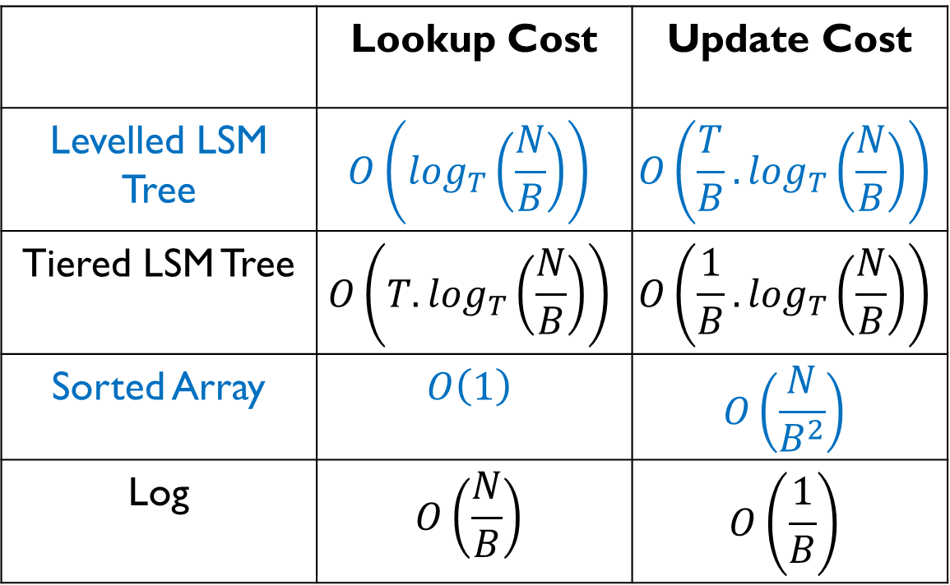
Cost Analysis- Summary
 | Lookup Cost | Update Cost
Levelled LSM Tree | $$O\left(\log_{T}\left(\frac{N}{B}\right)\right)$$ | $$O\left(\frac{T}{B}.\log_{T}\left(\frac{N}{B}\right)\right)$$
Tiered LSM Tree | $$O\left({T.log}_{T}\left(\frac{N}{B}\right)\right)$$ | $$O\left(\frac{1}{B}.\log_{T}\left(\frac{N}{B}\right)\right)$$
Sorted Array | $$O\left(1\right)$$ | $$O\left(\frac{N}{B^{2}}\right)$$
Log | $$O\left(\frac{N}{B}\right)$$ | $$O\left(\frac{1}{B}\right)$$
What happens if T is set to N/B?
The LSM tree becomes a sorted array!!!

Slide 65
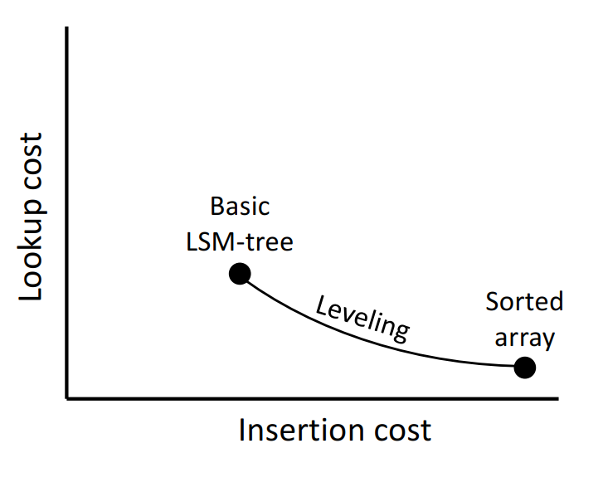
Cost Analysis- Summary

Slide 66
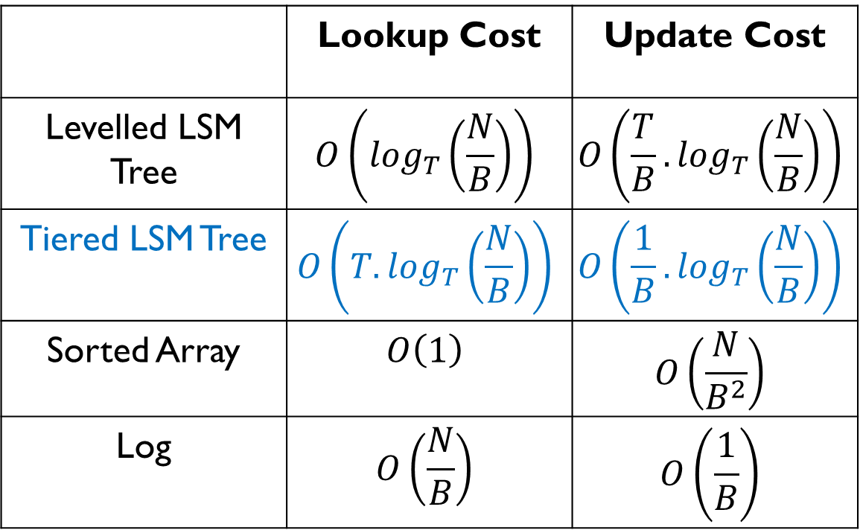
Cost Analysis- Summary
 | Lookup Cost | Update Cost
Levelled LSM Tree | $$O\left(\log_{T}\left(\frac{N}{B}\right)\right)$$ | $$O\left(\frac{T}{B}.\log_{T}\left(\frac{N}{B}\right)\right)$$
Tiered LSM Tree | $$O\left({T.log}_{T}\left(\frac{N}{B}\right)\right)$$ | $$O\left(\frac{1}{B}.\log_{T}\left(\frac{N}{B}\right)\right)$$
Sorted Array | $$O\left(1\right)$$ | $$O\left(\frac{N}{B^{2}}\right)$$
Log | $$O\left(\frac{N}{B}\right)$$ | $$O\left(\frac{1}{B}\right)$$
What happens if T is increased?

Slide 67
Cost Analysis- Summary
 | Lookup Cost | Update Cost
Levelled LSM Tree | $$O\left(\log_{T}\left(\frac{N}{B}\right)\right)$$ | $$O\left(\frac{T}{B}.\log_{T}\left(\frac{N}{B}\right)\right)$$
Tiered LSM Tree | $$O\left({T.log}_{T}\left(\frac{N}{B}\right)\right)$$ | $$O\left(\frac{1}{B}.\log_{T}\left(\frac{N}{B}\right)\right)$$
Sorted Array | $$O\left(1\right)$$ | $$O\left(\frac{N}{B^{2}}\right)$$
Log | $$O\left(\frac{N}{B}\right)$$ | $$O\left(\frac{1}{B}\right)$$
What happens if T is increased?
Lookup cost increases & update cost decreases

Slide 68
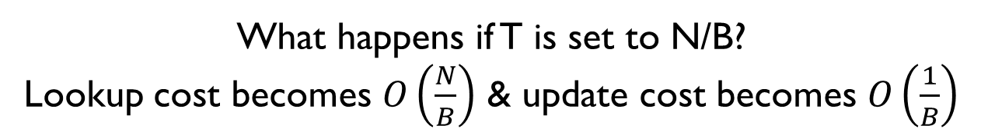
Cost Analysis- Summary
 | Lookup Cost | Update Cost
Levelled LSM Tree | $$O\left(\log_{T}\left(\frac{N}{B}\right)\right)$$ | $$O\left(\frac{T}{B}.\log_{T}\left(\frac{N}{B}\right)\right)$$
Tiered LSM Tree | $$O\left({T.log}_{T}\left(\frac{N}{B}\right)\right)$$ | $$O\left(\frac{1}{B}.\log_{T}\left(\frac{N}{B}\right)\right)$$
Sorted Array | $$O\left(1\right)$$ | $$O\left(\frac{N}{B^{2}}\right)$$
Log | $$O\left(\frac{N}{B}\right)$$ | $$O\left(\frac{1}{B}\right)$$
What happens if T is set to N/B?
Lookup cost becomes $O\left(\frac{N}{B}\right)$ & update cost becomes $O\left(\frac{1}{B}\right)$

Slide 69
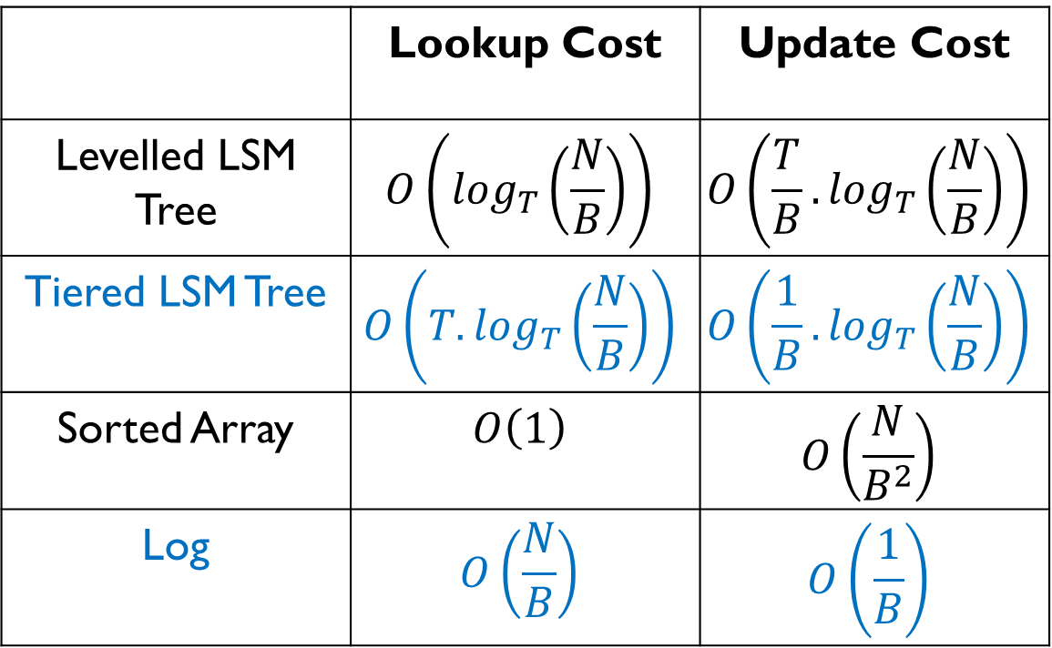
Cost Analysis- Summary
 | Lookup Cost | Update Cost
Levelled LSM Tree | $$O\left(\log_{T}\left(\frac{N}{B}\right)\right)$$ | $$O\left(\frac{T}{B}.\log_{T}\left(\frac{N}{B}\right)\right)$$
Tiered LSM Tree | $$O\left({T.log}_{T}\left(\frac{N}{B}\right)\right)$$ | $$O\left(\frac{1}{B}.\log_{T}\left(\frac{N}{B}\right)\right)$$
Sorted Array | $$O\left(1\right)$$ | $$O\left(\frac{N}{B^{2}}\right)$$
Log | $$O\left(\frac{N}{B}\right)$$ | $$O\left(\frac{1}{B}\right)$$
What happens if T is set to N/B?
The LSM tree becomes a Log!!!

Slide 70
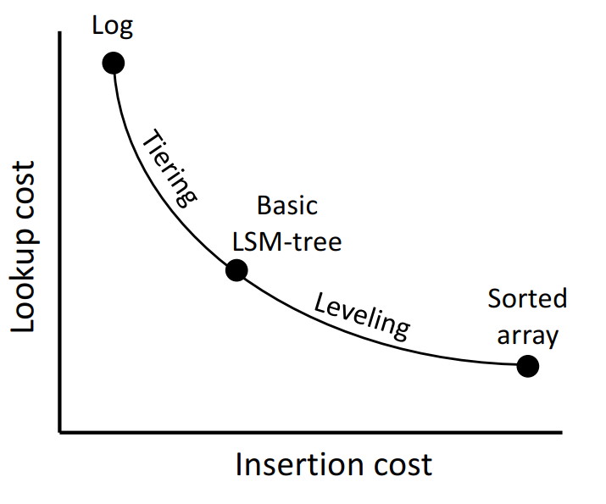
Cost Analysis- Summary

Slide 71
Bloom Filters
To speed up point queries, every run has a corresponding Bloom filter in main memory.
A point lookup probes a run’s filter before accessing the run in secondary storage.
If the filter returns negative, the target key does not exist in the run, and so the lookup skips accessing the run and saves one I/O.
If a filter returns positive, then the target key may exist in the run, so the lookup probes the run at a cost of one I/O.

Slide 72

Bloom Filters
If the run actually contains the key, the lookup terminates.
Otherwise, we have a “false positive” and the lookup continues to probe the next run.
False positives increase the I/O cost of lookups.
The false positive rate (FPR) depends on (1) the number of entries in a run, and (2) the number of bits in main memory allocated to the run’s filter.
$$FPR=e^{−\frac{bits}{entries} ln\left(2\right)2}$$

Slide 73
Fence Pointers vs Bloom Filters
Using fence pointers, you can know exactly where the data is located in the run. Hence, there is no I/O cost for probing a run with fence pointer.
On the other hand, using bloom filter you may know whether data is located in that run or not.

Slide 74

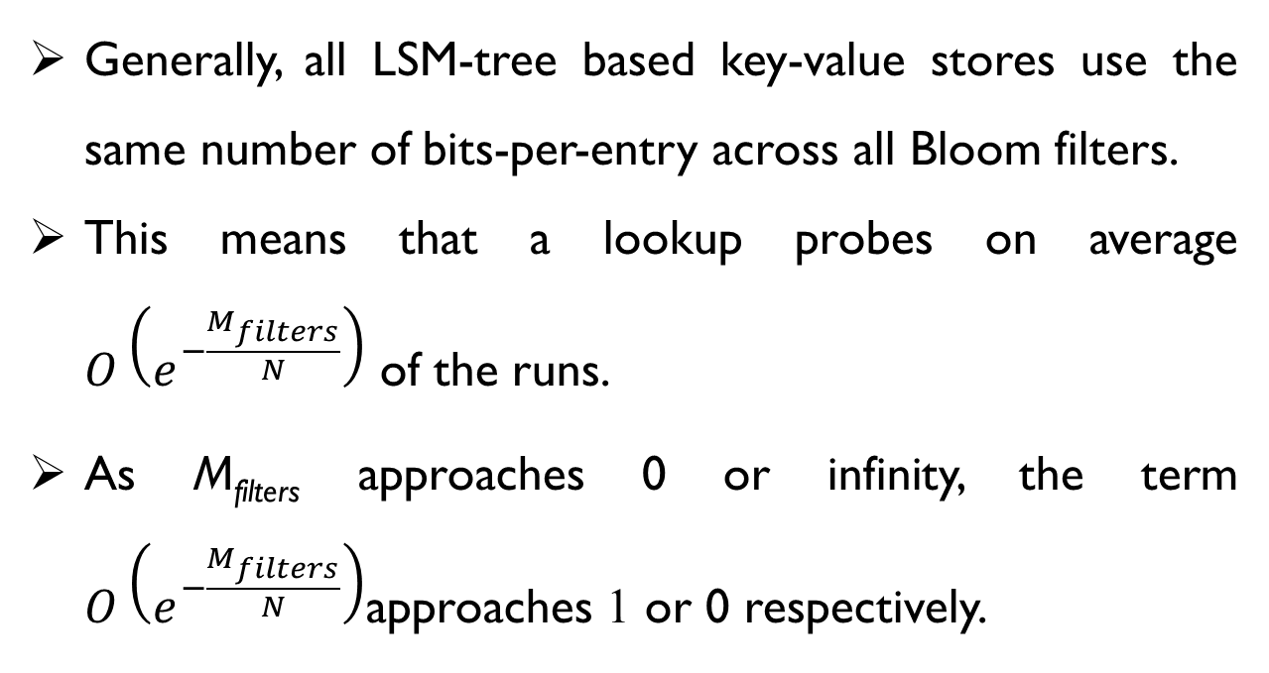
Bloom Filters
$$FPR=e^{−\frac{bits}{entries} ln\left(2\right)2}$$
Generally, all LSM-tree based key-value stores use the same number of bits-per-entry across all Bloom filters.
This means that a lookup probes on average $O\left(e^{−\frac{M_{filters}}{N}}\right)$ of the runs.
As M_{filters} approaches 0 or infinity, the term $O\left(e^{−\frac{M_{filters}}{N}}\right)$approaches 1 or 0 respectively.

Slide 75
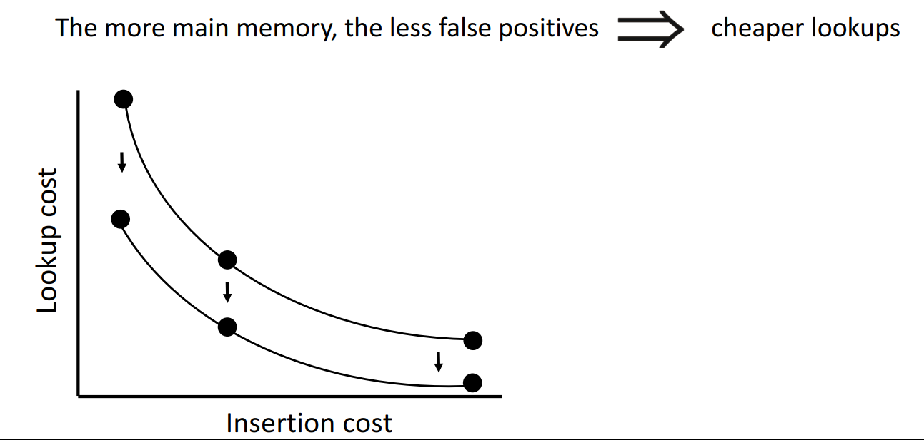
Bloom Filters

Slide 76

Bloom Filters
$$FPR=e^{−\frac{bits}{entries} ln\left(2\right)}$$
Existing studies use 10 bits per entry for their Bloom filters by default
The corresponding false positive rate is ≈ 1%.
With this tuning, an average entry size of 128 bytes entails the Bloom filters being ≈ 2 orders of magnitude smaller than the raw data size.

Slide 77

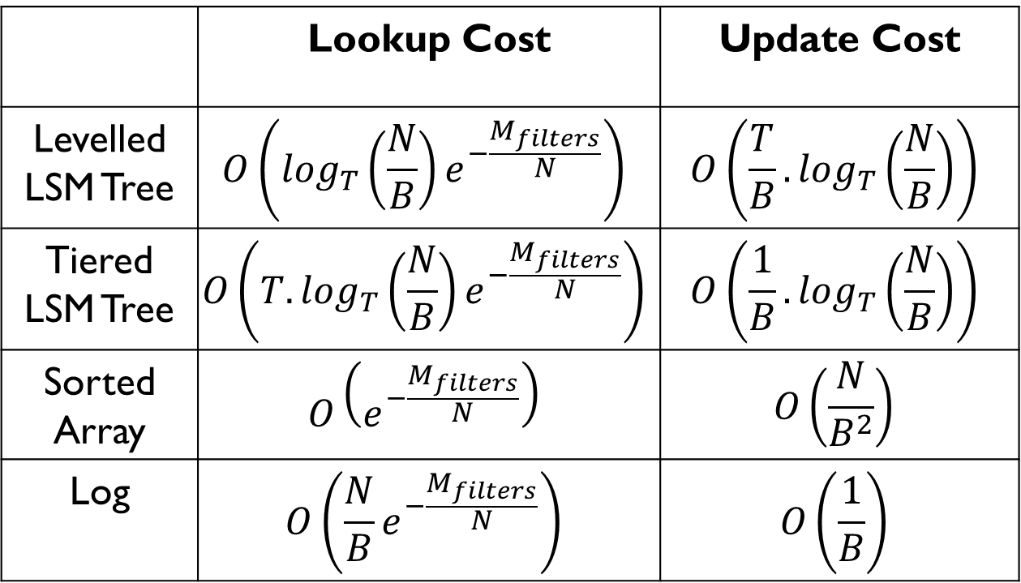
Cost Analysis- with Bloom Filter
 | Lookup Cost | Update Cost
Levelled LSM Tree | $$O\left(\log_{T}\left(\frac{N}{B}\right)e^{−\frac{M_{filters}}{N}}\right)$$ | $$O\left(\frac{T}{B}.\log_{T}\left(\frac{N}{B}\right)\right)$$
Tiered LSM Tree | $$O\left({T.log}_{T}\left(\frac{N}{B}\right)e^{−\frac{M_{filters}}{N}}\right)$$ | $$O\left(\frac{1}{B}.\log_{T}\left(\frac{N}{B}\right)\right)$$
Sorted Array | $$O\left(e^{−\frac{M_{filters}}{N}}\right)$$ | $$O\left(\frac{N}{B^{2}}\right)$$
Log | $$O\left(\frac{N}{B}e^{−\frac{M_{filters}}{N}}\right)$$ | $$O\left(\frac{1}{B}\right)$$
Because we probe on average only $O\left(e^{−\frac{M_{filters}}{N}}\right)$ of the runs.

Slide 78
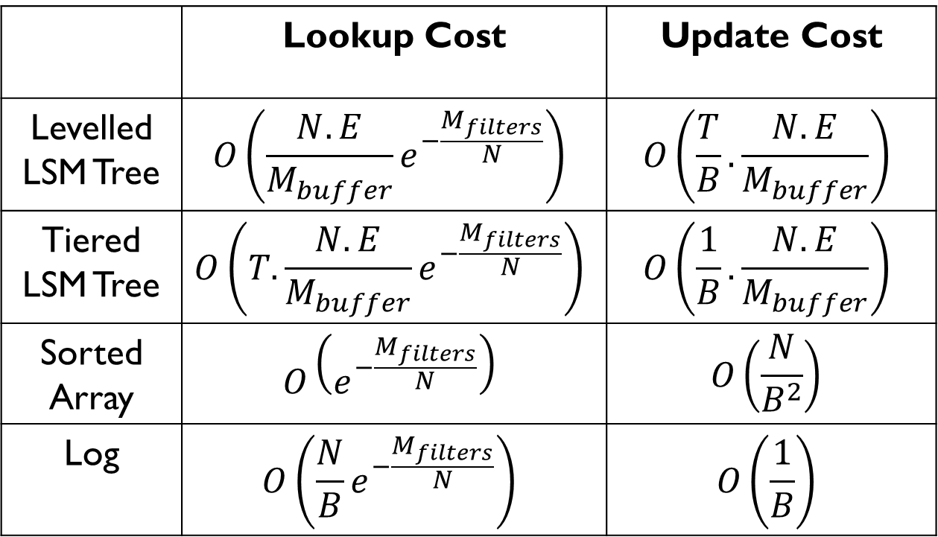
Cost Analysis- with Bloom Filter
 | Lookup Cost | Update Cost
Levelled LSM Tree | $$O\left(\frac{N.E}{M_{buffer}}e^{−\frac{M_{filters}}{N}}\right)$$ | $$O\left(\frac{T}{B}.\frac{N.E}{M_{buffer}}\right)$$
Tiered LSM Tree | $$O\left(T.\frac{N.E}{M_{buffer}}e^{−\frac{M_{filters}}{N}}\right)$$ | $$O\left(\frac{1}{B}.\frac{N.E}{M_{buffer}}\right)$$
Sorted Array | $$O\left(e^{−\frac{M_{filters}}{N}}\right)$$ | $$O\left(\frac{N}{B^{2}}\right)$$
Log | $$O\left(\frac{N}{B}e^{−\frac{M_{filters}}{N}}\right)$$ | $$O\left(\frac{1}{B}\right)$$
This notation is used in the paper “Monkey”

Slide 79
LSM Tree Design Space

Slide 80
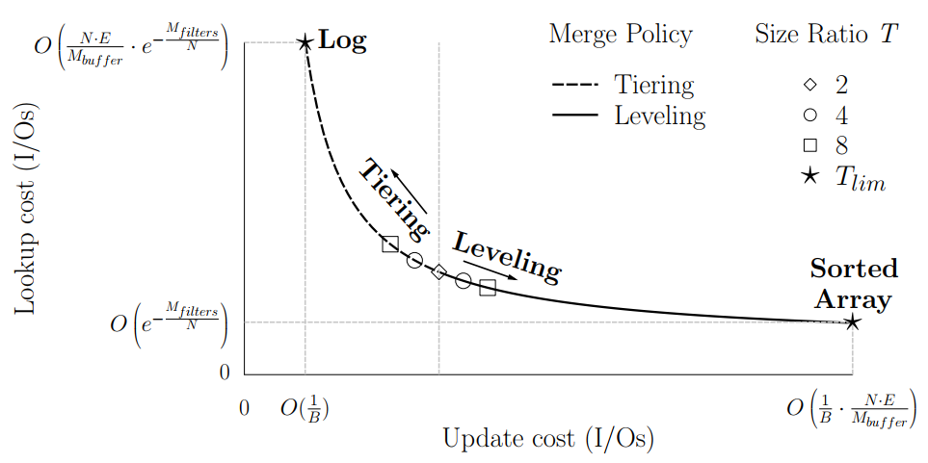
LSM Tree Design Space

Slide 81
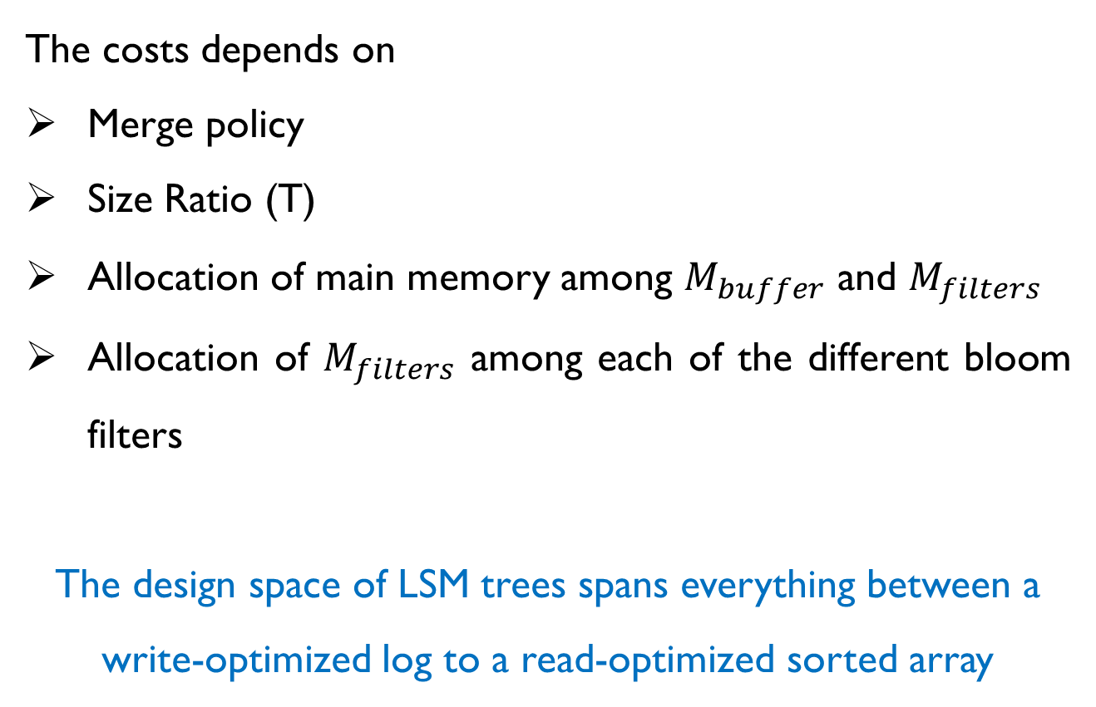
LSM Tree Design Space
The costs depends on
Merge policy
Size Ratio (T)
Allocation of main memory among $M_{buffer}$ and $M_{filters}$
Allocation of $M_{filters}$ among each of the different bloom filters
The design space of LSM trees spans everything between a write-optimized log to a read-optimized sorted array

Slide 82
LSM Tree Design Space
Tuning the Merge Policy and Size Ratio
When the size ratio T is set to 2, the complexities of lookup and update costs for tiering and leveling become identical.
As T is increased with tiering/leveling respectively, update cost decreases/increases whereas lookup cost increases/decreases.
Tiering and leveling are complementary methods for navigating the same trade-off continuum.

Slide 83
LSM Tree Design Space
Tuning the Merge Policy and Size Ratio
As the size ratio T approaches its limit value T_{lim}, the number of levels L approaches 1. When L is 1, a tiered LSM-tree degenerates to log while a leveled LSM-tree degenerates to sorted array.
In this way, an LSM-tree can be tuned anywhere between these two extremes in terms of their performance properties.

Slide 84
LSM Tree Design Space
Tuning Main Memory Allocation
The limits of the curve in Figure 4 are determined by the allocation of main memory among the filters M_{filters} and the buffer M_{buffer.}
The main memory occupied by the Bloom filters and buffer accounts for a significant portion of a system’s (infrastructure and running) cost.

Slide 85
Design Space Contentions
Contention #1
Contention 1 arises in how we allocate a given amount of main memory M_{filters} among the different Bloom filters.
How do we optimally allocate M_{filters} among the different Bloom filters to minimize lookup cost?

Slide 86
Design Space Contentions
Contention #2
Contention 2 arises in how to allocate the available main memory between the buffer and the filters.
Allocating more main memory to the buffer on one hand decreases both lookup cost and update cost, but on the other hand it decreases the Bloom filters’ accuracy thereby increasing lookup cost.
How do we strike the best balance?

Slide 87
Design Space Contentions
Contention #3
Contention 3 arises in how to tune the size ratio and merge policy.
This is complicated because workloads consist of different proportions of (1) updates, (2) zero result lookups, (3) non-zero-result lookups, and (4) range lookups of different selectivities.
How do we find the best size ratio and merge policy for a particular application workload?

Slide 88

Monkey: Optimal Navigable Key-Value Store

Slide 89
Monkey
An LSM tree based key-value store
Is able to reach the Pareto curve and find the best possible balance between lookups and updates
Maximized throughput for uniformly random workloads

Slide 90
Monkey- Key Features
Design Knobs
Minimizing Lookup Cost
Performance Prediction
Autotuning

Slide 91
Monkey- Key Features
Design Knobs
Minimizing Lookup Cost
Performance Prediction
Autotuning

Slide 92
Monkey- Key Features
Monkey transforms the design elements that impact worst-case behavior into tuning knobs, and it can alter its behavior by adjusting them.
These knobs:
The size ratio among levels T
The merge policy (leveling vs. tiering)
The false positive rates assigned to Bloom filters across different levels
The allocation of main memory M between the buffer M_{buffer} and the filters M_{filters}

Slide 93
Monkey- Key Features
Design Knobs
Minimizing Lookup Cost
Performance Prediction
Autotuning

Slide 94
Monkey- Key Features
Optimal allocation of main memory across Bloom filters to minimize lookup cost.
The key insight is that lookup cost is proportional to the sum of the false positive rates (FPR) of all the Bloom filters.
Monkey achieves faster reads than the state of the art for any main memory budget, and so it shifts the entire trade-off curve vertically down to the Pareto curve.

Slide 95
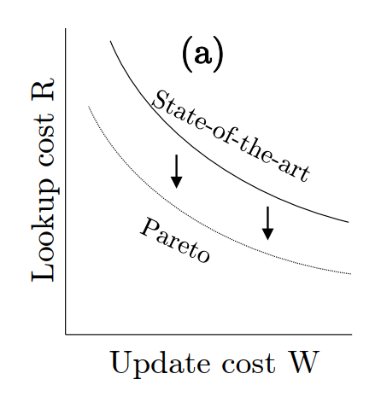
Monkey- Key Features

Slide 96
Monkey- Key Features
Design Knobs
Minimizing Lookup Cost
Performance Prediction
Autotuning

Slide 97
Monkey- Key Features
The ability to predict how changing a design decision or an environmental parameter would impact worst-case performance.
Derived closed-form models for the worst-case I/O costs of lookups and updates in terms of the LSM-tree design space knobs.

Slide 98
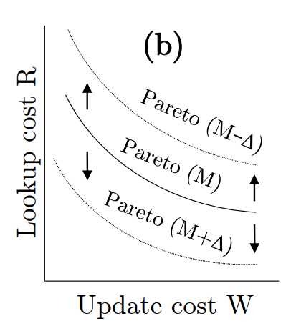
Monkey- Key Features

Slide 99
Monkey- Key Features
Design Knobs
Minimizing Lookup Cost
Performance Prediction
Autotuning

Slide 100
Monkey- Key Features
The ability to holistically self-tune to maximize the worst-case throughput
Achieve this in two steps:
Asymptotic analysis to map the design space and thereby devise a rule for how to allocate main memory between the buffer and the filters.
Modeling worst-case throughput with respect to (1) lookup cost and update cost, (2) the proportion of lookups and updates in the workload, and (3) the costs of reads and writes to persistent storage
An algorithm that quickly searches the Pareto curve for the balance between lookup and update cost that maximizes the worst-case throughput.

Slide 101
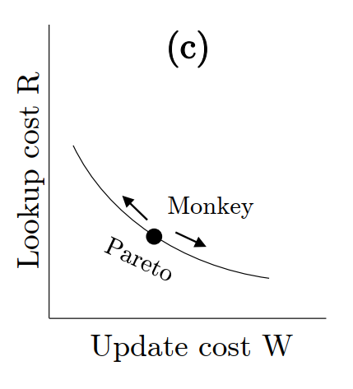
Monkey- Key Features

Slide 102
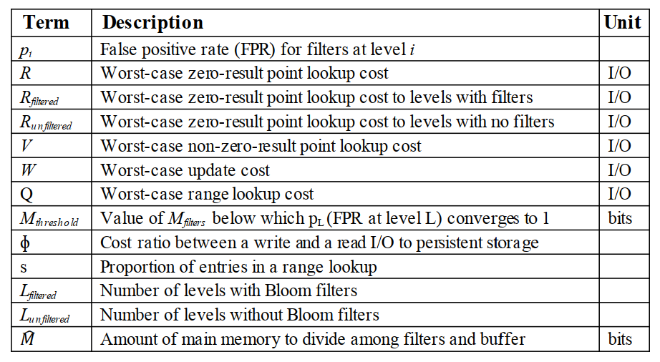
Monkey- Terminology

Slide 103
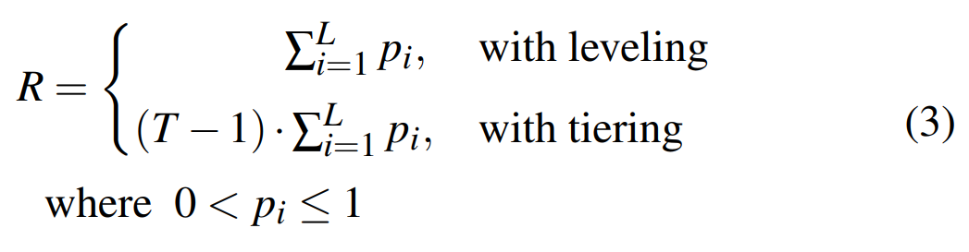
Monkey- Minimizing Lookup Cost
R is denoted as the worst-case expected I/O cost of a zero-result point lookup
So average worst case lookup cost is

Slide 104
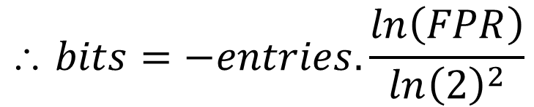
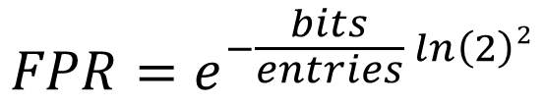
Monkey- Minimizing Lookup Cost
Main memory footprint
Let’s recall:
$$FPR=e^{−\frac{bits}{entries} ln\left(2\right)2}$$
$$ bits=−entries.\frac{ln\left(FPR\right)}{ln{\left(2\right)}^{2}}$$

Slide 105

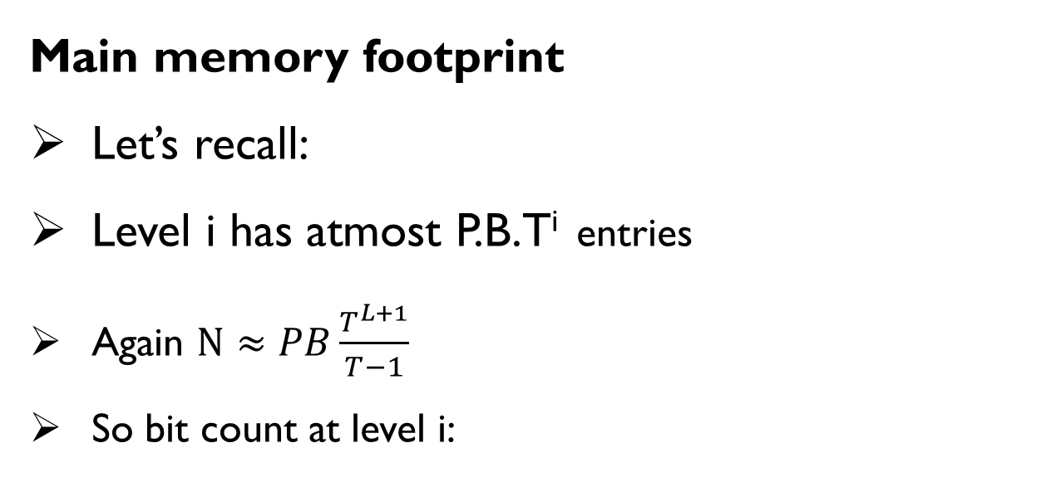
Monkey- Minimizing Lookup Cost
Main memory footprint
Let’s recall:
Level i has atmost P.B.T^{i} entries
Again $N≈PB\frac{T^{L+1}}{T−1}$
So bit count at level i:

Slide 106
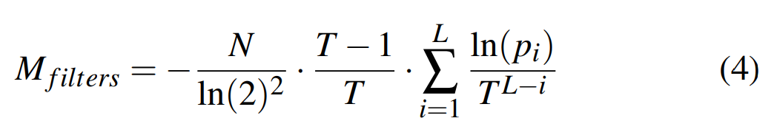
Monkey- Minimizing Lookup Cost
Main memory footprint
finding the optimal assignment of FPRs across the different levels that minimizes M_{filters} for any user-specified value of R.

Slide 107

Monkey- Minimizing Lookup Cost

Slide 108
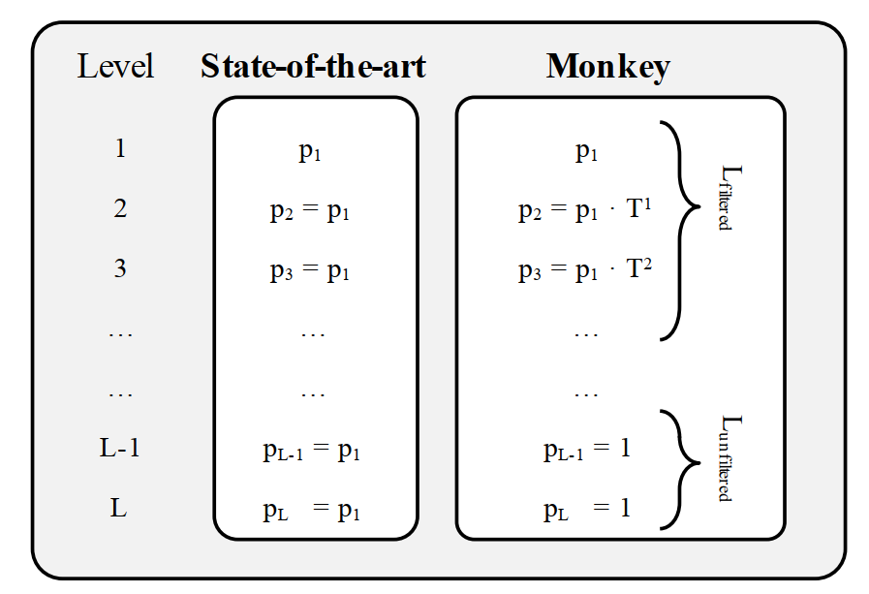
Monkey- Minimizing Lookup Cost

Slide 109
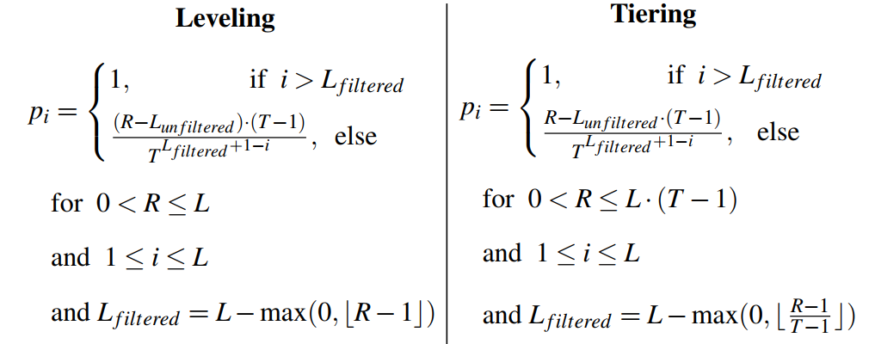
Monkey- Minimizing Lookup Cost

Slide 110
Monkey- Minimizing Lookup Cost
The intuition is that-
The I/O cost of probing any run is the same regardless of its size (due to the fence pointers)
But the amount of main memory needed for achieving a low FPR at deeper levels is significantly higher since they have exponentially more entries.

Slide 111
Monkey- Minimizing Lookup Cost
In summary, Monkey minimizes the main memory footprint for the Bloom filters for a given lookup cost R by-
Finding the optimal number of levels L_{filtered} to which Bloom filters should be allocated
Setting the FPR for each of these levels to be proportional to its capacity

Slide 112
Monkey
The Rest….
Self Study (included in Term Final)

Slide 113
Reference
Niv Dayan, Manos Athanassoulis, and Stratos Idreos. 2017. Monkey: Optimal Navigable KeyValue Store. In Proceedings of the ACM SIGMOD International Conference on Management of Data. 79–94
O’NEIL, P., CHENG, E., GAWLICK, D., AND O’NEIL, E. 1996. The log-structured merge-tree (LSMtree). Acta Inf. 33, 4, 351–385.
Chen Luo, Michael J. Carey. LSM-based Storage Techniques: A Survey.

Slide 114
THANK YOU!!!

